Slide 1
GERMAN CREDIT CARD BANK ANALYSIS
Conducted correlation analysis and data visualization to identify relationships between customer attributes and credit risk.
Marga Aragon

Slide 2
A German Bank is lending money to individuals.

Slide 3
THEY WANT TO FIND OUT:
THE CHARACTERISTICS OF THE PEOPLE WHO PAY BACK.
THE CHARACTERISTICS OF THE PEOPLE WHO DEFAULT ON THEIR LOANS.

Slide 4
Which columns or (independent) variables
would significantly influence the Y value (whether someone fulfills the terms of credit agreement
or not)? List at least three and explain why?

Slide 5
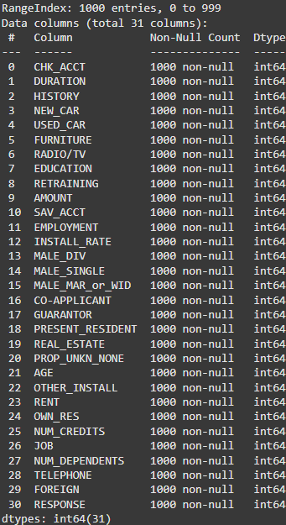
Data Columns
JOB = employment status or job security is a significant factor, as people with steady jobs are more likely to make consistent payments
CHK_ACCT = This will indicate the status of the person's checking account. People with more stable account balances might be more likely to fulfill their credit agreements
HISTORY = A person's credit history can show how likely they can fulfill credit agreements.

Slide 6

What are some general findings from basic (descriptive) statistics from the dataset?
The dataset shows that most people have a stable checking account,
with loan durations averaging 21 months but going up to 6 years.
The loan amounts vary a lot, from small loans of $250 to large loans over $18,000.
People in the dataset are mostly around 35 years old, with ages ranging from 19 to 75.
About 70% own their homes, which suggests they might be financially stable.
Around 70% of people pay back their loans, while 30% do not.

Slide 7

What portion of borrowers have paid back? What portion have defaulted on their loans?
70% of the borrowers have paid back their loans, while 30% have defaulted, based on the calculated RESPONSE average

Slide 8
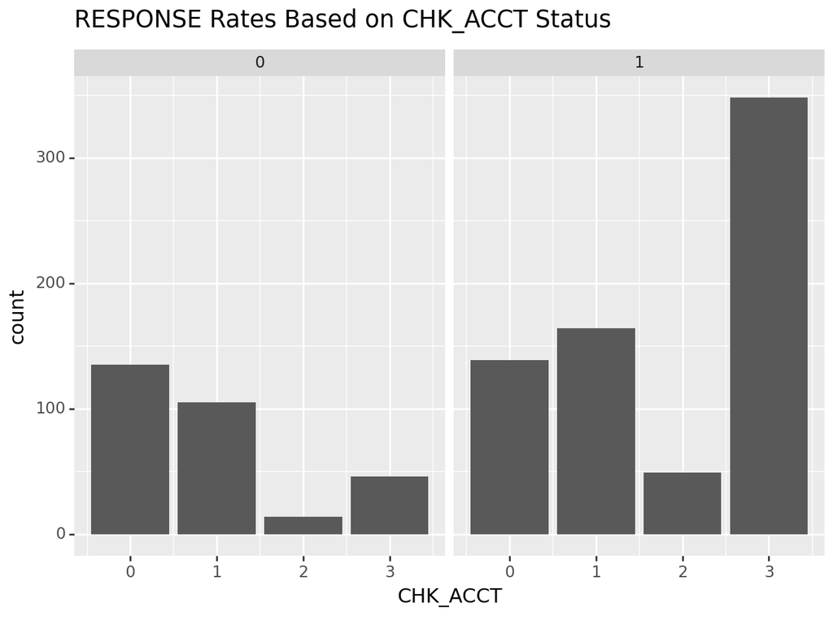
What is the relationship between RESPONSE and three other variables?
The correlation between CHK_ACCT and RESPONSE seem to have a positive relationship.
I do think that this status does have a significant affect to the RESPONSE rates, however
it is not a super huge factor as it is at 0.3.

Slide 9
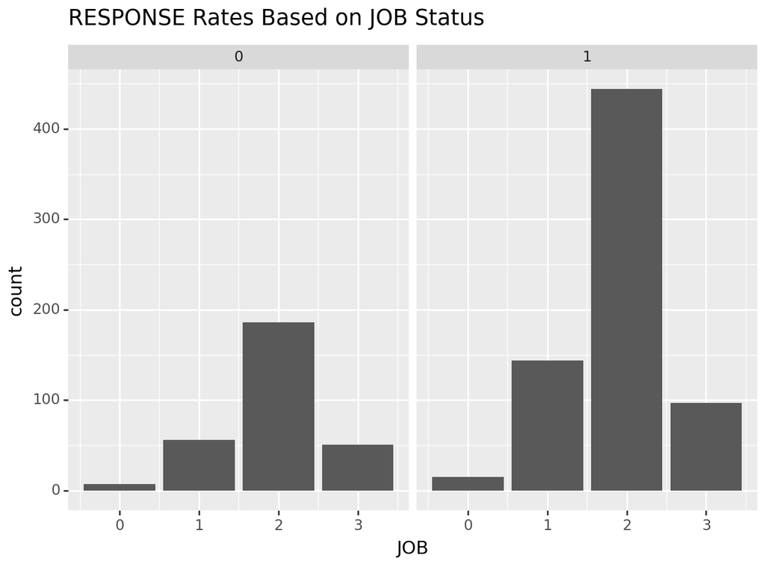
0.04 correlation is very weak. I believe the correlation between these two variables is very low, meaning there is no significant relationship between JOB and Response.

Slide 10
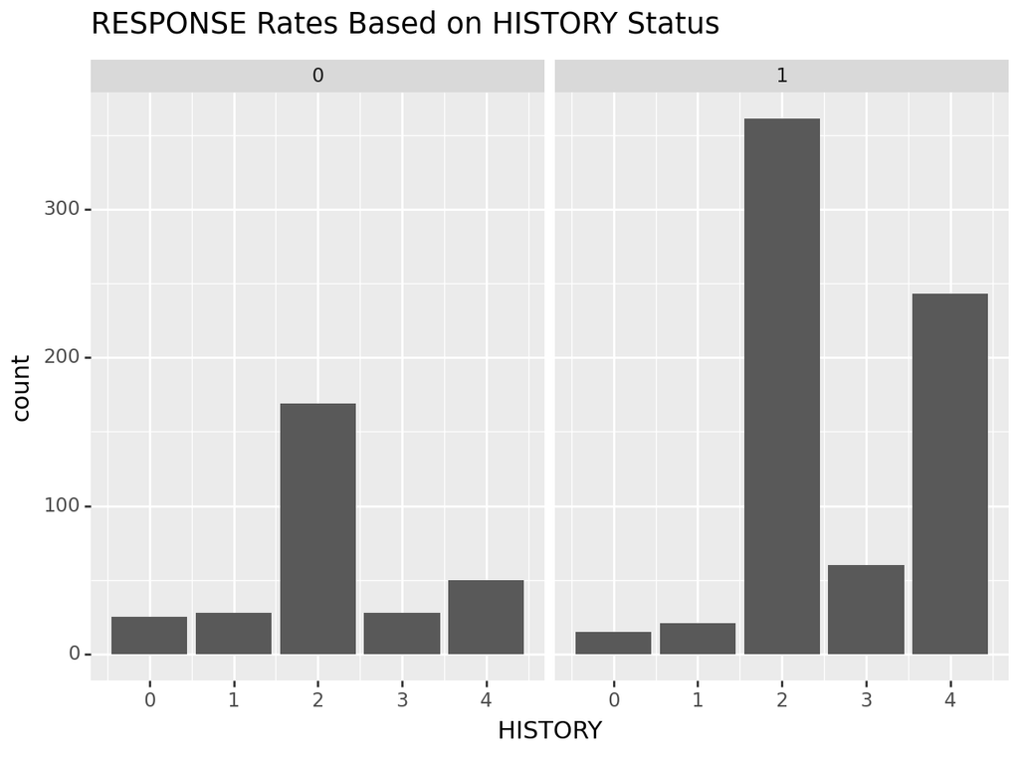
Similarly with CHK_ACCT, HISTORY has a significant positive relationship with RESPONSE,
however, it is not the biggest factor to the RESPONSE rates, given that the correlation is at 0.2

Slide 11
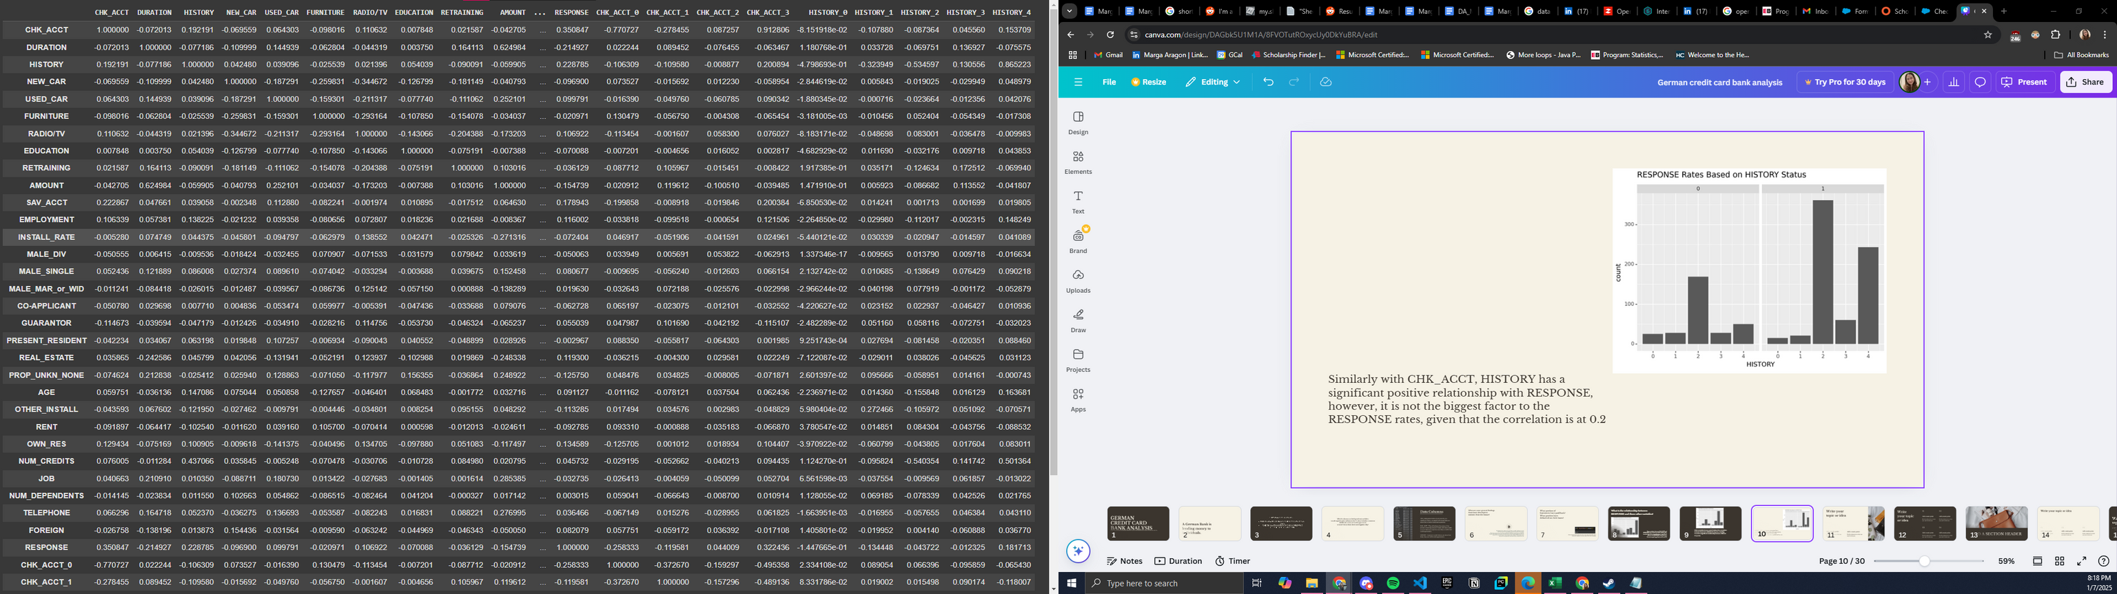

df.corr(numeric_only = True)

Slide 12
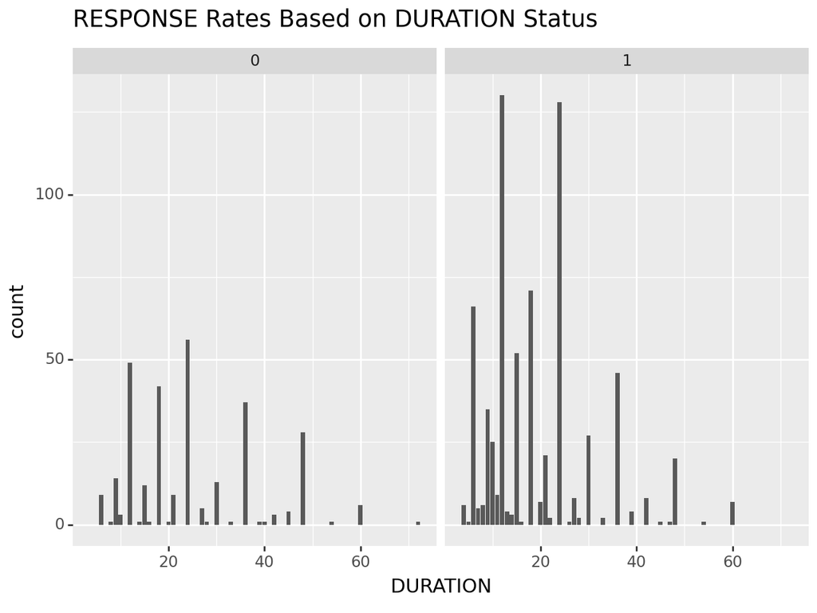
Longer loan durations may be associated with a higher risk of default, while shorter loan terms seem to correlate with better loan repayment behavior.

Slide 13
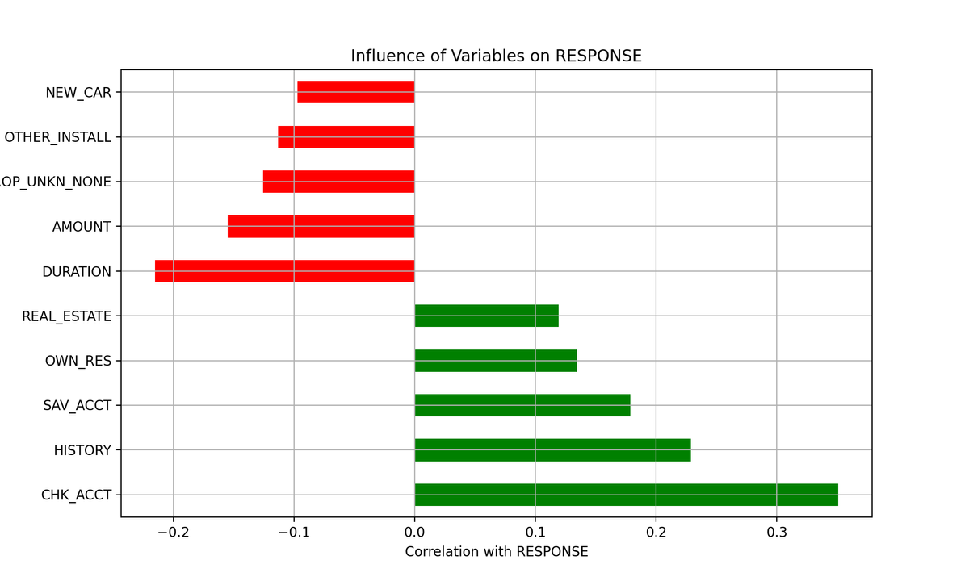
Variables like REAL_ESTATE, OWN_RES, SAV_ACCT, HISTORY, and CHK_ACCT appear to be the most influential in determining whether someone will repay their loan or default.

Slide 14
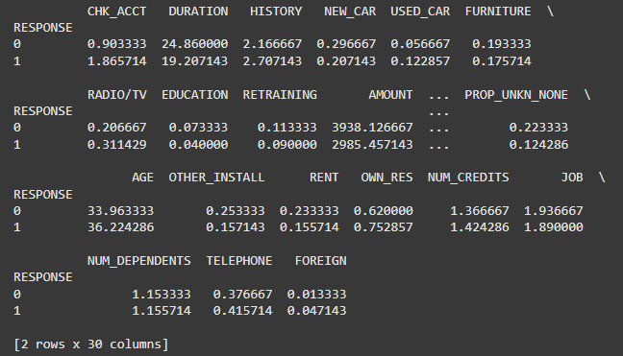
What are the characteristics of the people who have paid back?

Slide 15
People who pay back loans typically have stable jobs, good credit history,
stable checking account balances, smaller loan amounts, and
shorter loan durations. On the other hand, those who default tend to have poorer credit history,
less stable financial situations (lower checking account status), longer loan durations,
larger loan amounts, and less stable employment. These patterns indicate that financial stability,
manageable loan sizes, and a strong credit history are crucial for successfully repaying loans,
whereas larger financial commitments and job instability increase the likelihood of default

Slide 16
What is your general recommendation for the German bank?
To minimize defaults, the bank should focus on lending to individuals with stable jobs,
good credit histories, and positive checking account statuses. Limiting loan amounts
to what is manageable for the borrower and offering shorter loan durations may reduce the risk of default.
Additionally, borrowers with lower credit scores or unstable financial situations should be
subjected to stricter lending criteria or offered loans with higher interest rates to compensate
for the increased risk. The bank could also provide financial education to
improve borrowers' financial management skills, helping them avoid default.

